Slide 1
Restaurant

Slide 2
Team member
Fatma mohamed elsayed
Fatma ebrahim abu ELnasr
Ghada ahmed elsayed
Hager hamdy al atar
Farah fawzy awad
Amr khaled

Slide 3
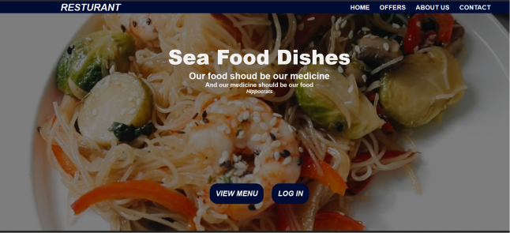
overview
Online reservation to restaurant by user account the home page will be available it
For all including offers to food and description about chef and restaurant social
account and contact when user click on login will be access to log in page can
use his account and password as admin or user if did not have account will
go to sign up page then he can order food as he want with visa or cash.

Slide 4
Home page when user access to website

Slide 5
Offer page
The offer page

Slide 6
About us page

Slide 7
Chef page

Slide 8
Contact page

Slide 9
When click on menu button

Slide 10
Log in page
When click login button

Slide 11
sign up
page

Slide 12
Menu page

Slide 13
Feedback

Slide 14
Order page

Slide 15
Thank you

